Slide 1
Applications of Asynchronous Components in Processor Design
Evan Smith
CSE 661, Abdallah

Slide 2
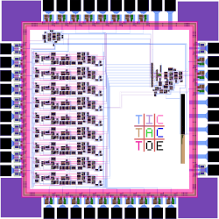
What is an asynchronous system?
No clocking
Removes stalls!
Uses communication protocols for control flow
Event-Driven Architecture
Analogous to OOP
Components <-> classes

Slide 3
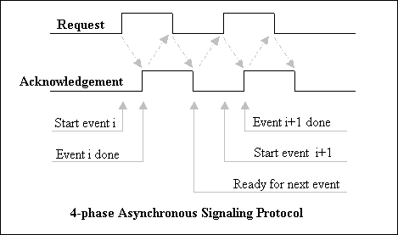
Handshaking
https://hdlplanet.tripod.com/comp_arch/async_4.html

Slide 4
Some Pros and Cons
PROS
CONS
Delay-insensitive (or quasi-delay insensitive)
Much lower power consumption
Parallel processing can be simpler
Silicon compilation is possible
Transfer between components can be slower than synch
Hardware design is more complicated
Difficult to test
Not the norm, so fewer resources

Slide 5
Sampling of Async Processor Research
AMULET(1-3)
Proof of concept
Competitive with sync (ARM9)
SAMIPS
Reproduces sync structure
GALS (Globally Async, Locally Sync)
FPGA possibilities
Can create async systems using sync tools
Lowers bar for development (to a point)
https://ieeexplore.ieee.org/document/878304

Slide 6
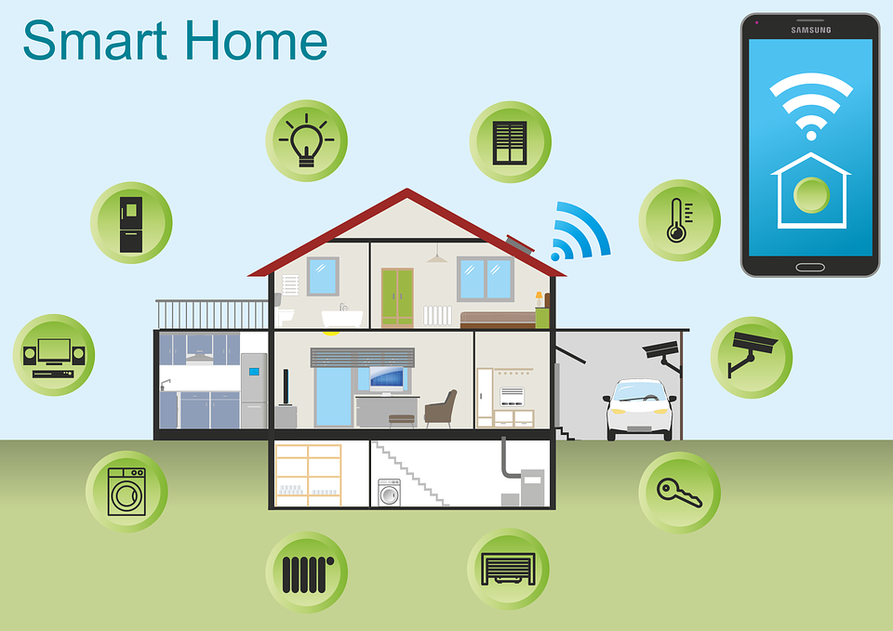
Sensor Network Applications
Component Parallelism
Analog sensing
Distributed systems / dense sensors
SNAP/LE and BitSNAP
Extremely power-efficient
Can handle dynamically sized inputs
GPS
Split-brain approach
https://roboticsandautomationnews.com/2020/05/07/smart-home-system-all-you-need-to-know/32126/

Slide 7
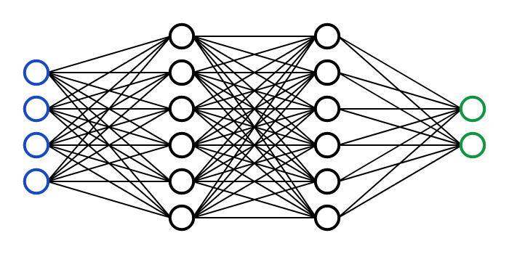
Neural Network Applications
DYNAPS
Captures information from event-timing
Async mesh routing required!
Digital Neurosynaptic Core
Focuses on mimicking NN structures, not brains
1:1 ratio of hardware:software
Network spikes measurable in-place
https://victorzhou.com/series/neural-networks-from-scratch/

Slide 8
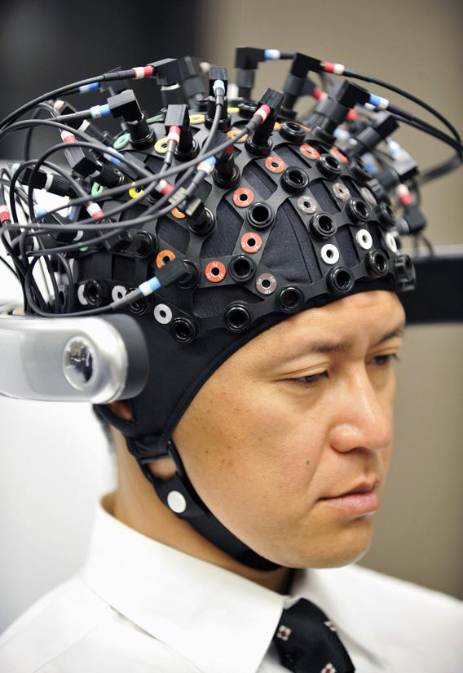
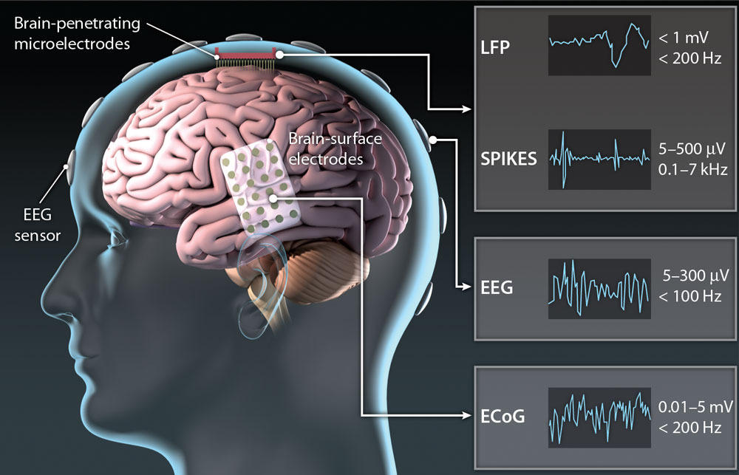
Medical Applications
Brain-Computer Interfaces (BCIs)
Large numbers of analog inputs
Extremely critical power constraints
Often closed systems
Smaller footprint
Able to serve multiple functions
https://stm.sciencemag.org/content/5/210/210ps17/tab-figures-data
https://slate.com/technology/2013/03/brain-computer-interfaces-could-neural-implants-give-you-telekinesis.html

Slide 9


Questions?

